Slide 1

High Gain Backward Lasing in
Atmospheric Air: Remote Atomic
Oxygen and Nitrogen Lasers
Arthur Dogariu and Richard Miles
Princeton University, Princeton, NJ 08540, USA
adogariu@princeton.edu
Financial support: US Office of Naval Research
Niitek/Chemring

Slide 2
Outline
Motivation – backwards lasing
Atomic Oxygen and Nitrogen Lasers – two photon excitation
Similarities - Lasing properties (divergence, gain, spectra, coherence)
Differences - Molecular dissociation of O₂ and N₂; double pulsing
Molecular dissociation
Dual lasing for trace detection
Conclusions

Slide 3
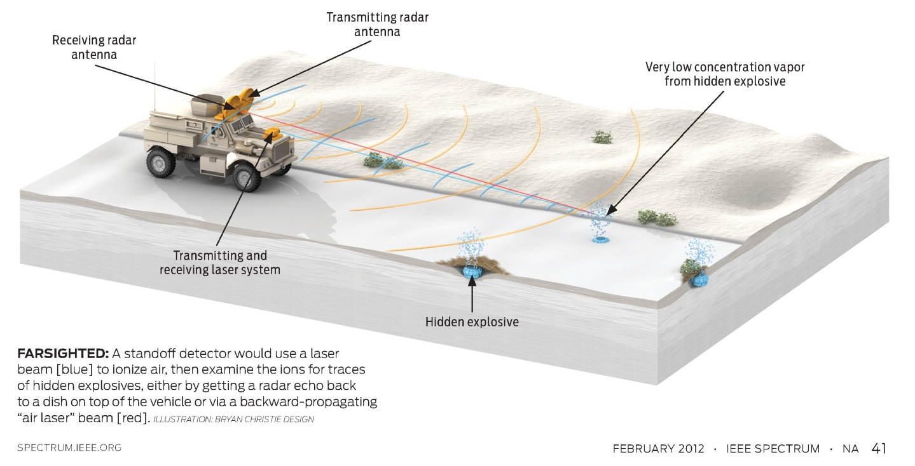




Slide 4
Motivation – remote sensing
Target (trace species)
Incident Focused Collinear Beam
Back-reflected Signal
Laser-based remote trace species detection methods rely on backscattered light
Incoherent light is non-directional, coherent light has the wrong direction!
Need for coherent light source at the target – remote laser source

Slide 5
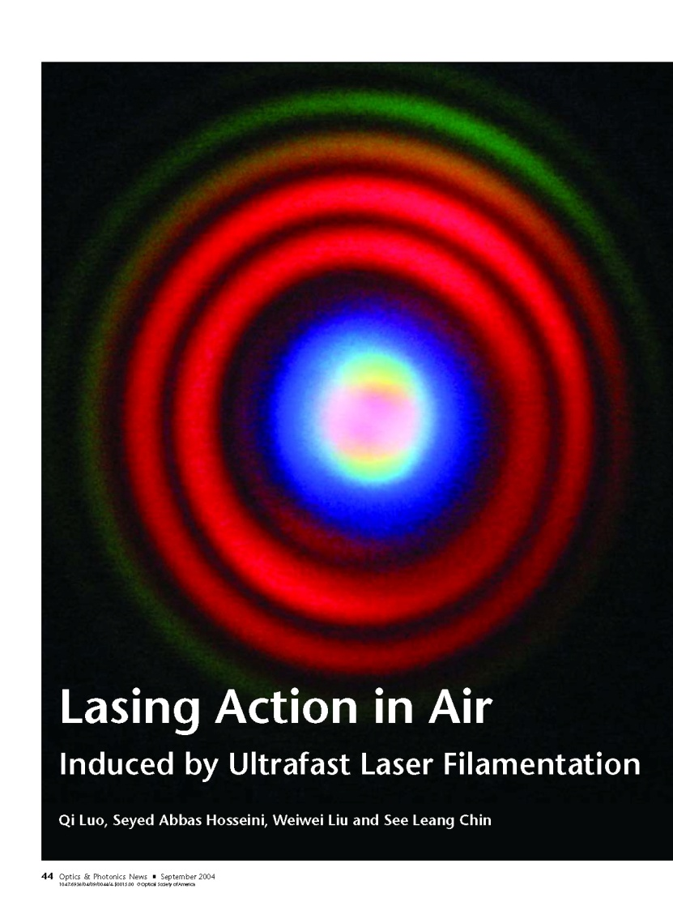
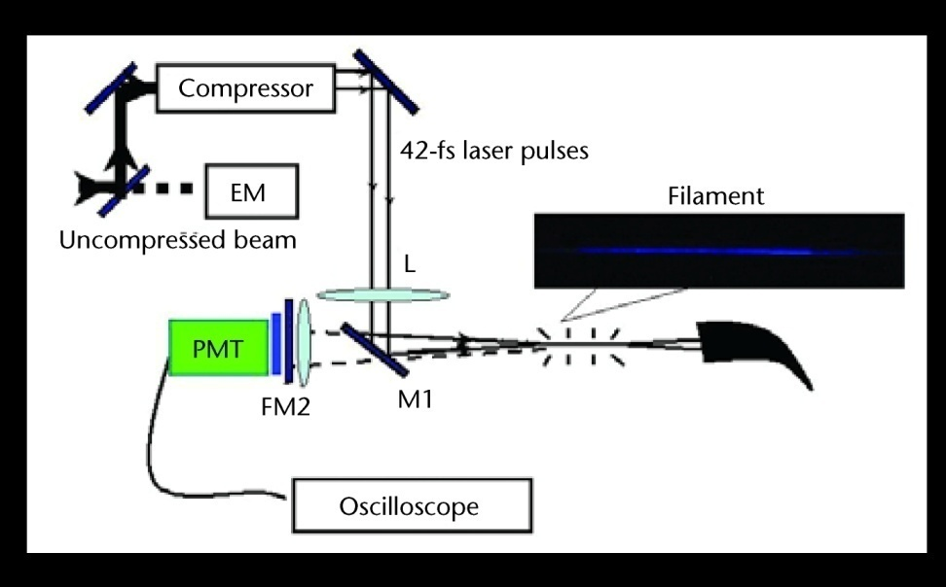
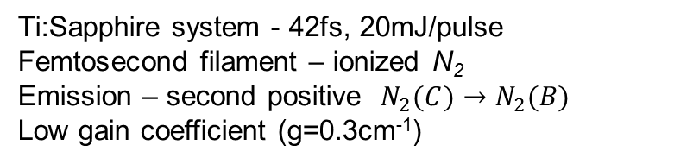
Background
Previous work- UV emission from molecular nitrogen excited by femtosecond filaments
Ti:Sapphire system - 42fs, 20mJ/pulse
Femtosecond filament – ionized N₂
Emission – second positive $N_{2}(C)→N_{2}(B)$
Low gain coefficient (g=0.3cm⁻¹)
N₂(C) →N₂(B)
Luo et al., Optics and Photonics News, p.44, Sept. 2004
Luo et al., Appl. Phys. B 76, 337 (2003)

Slide 6
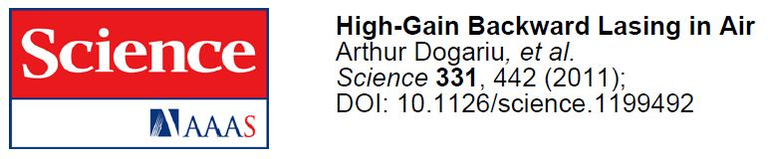
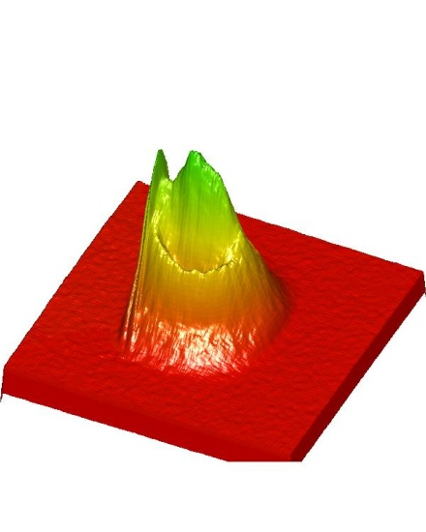
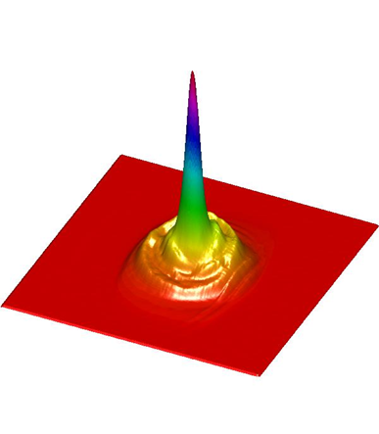
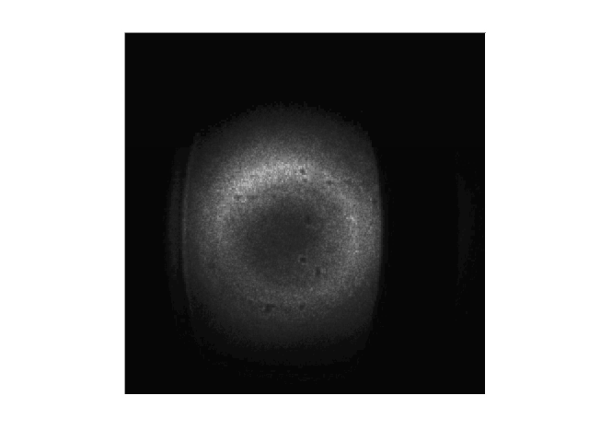
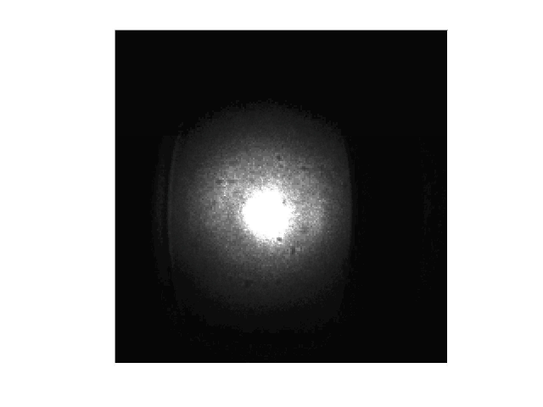
Air lasing:
Atomic Oxygen Emission
Two-photon dissociation of O₂
Two-photon excitation of O
Emission at 845nm and high gain → coherent emission in the backwards direction

Slide 7
High gain lasing
L
d
Backwards coherent emission vs. total non-directional incoherent emission shows strong, highly directional gain.
Coherent emission is 500 times stronger than incoherent emission
500 = e^{gL}, where L=1 mm.
Gain coefficient g = 62 cm^{-1.}
High optical gain plus high directionality (low divergence) lead to six orders of magnitude enhancement for backscattered signal.
Gain Region
L/d = 100 - 500
Threshold
High nonlinearity
Dogariu et al., Science 331, 442 (2011) .

Slide 8
Back Emission vs. gain length
Backwards emission signal normalized by the ultraviolet pump pulse vs. the position of the gain termination region.
A glass slide used to terminate the pump beam propagation is scanned through the Rayleigh range of the pump beam while the backwards emission is monitored.
The rapid growth in the signal moving from a position of -1 to 0 mm (at least two orders of magnitude) shows the nonlinearity with the gain path length. Gain coeff. 40-80 cm⁻¹

Slide 9
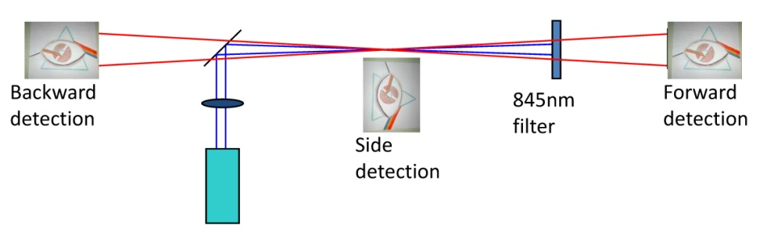
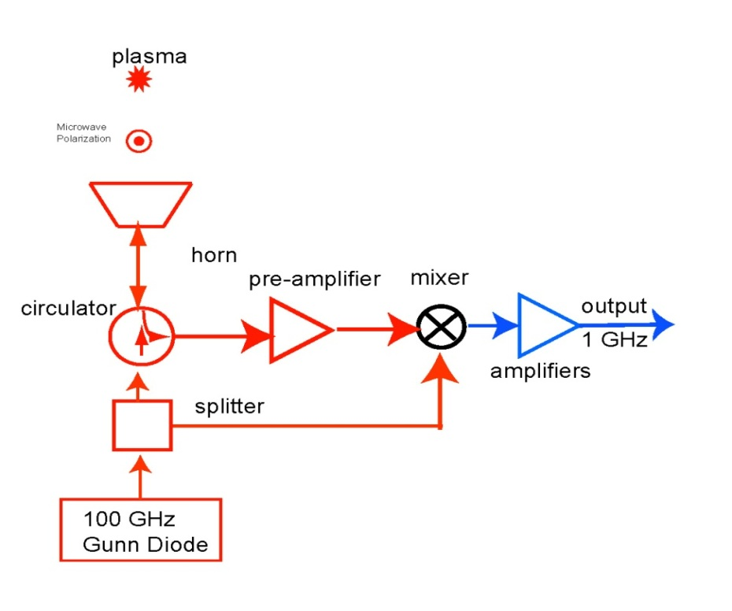
Air laser and Radar REMPI:
Emission vs Ionization
Forward and backward detectors monitor the emission (lasing)
The 100 GHz microwave system monitors the Radar REMPI signal (ionization)
The REMPI (or RIS) signal measures the density of excited oxygen atoms
REMPI – Resonantly Enhanced Multi-Photon Ionization
RIS – Resonance Ionization Spectroscopy

Slide 10
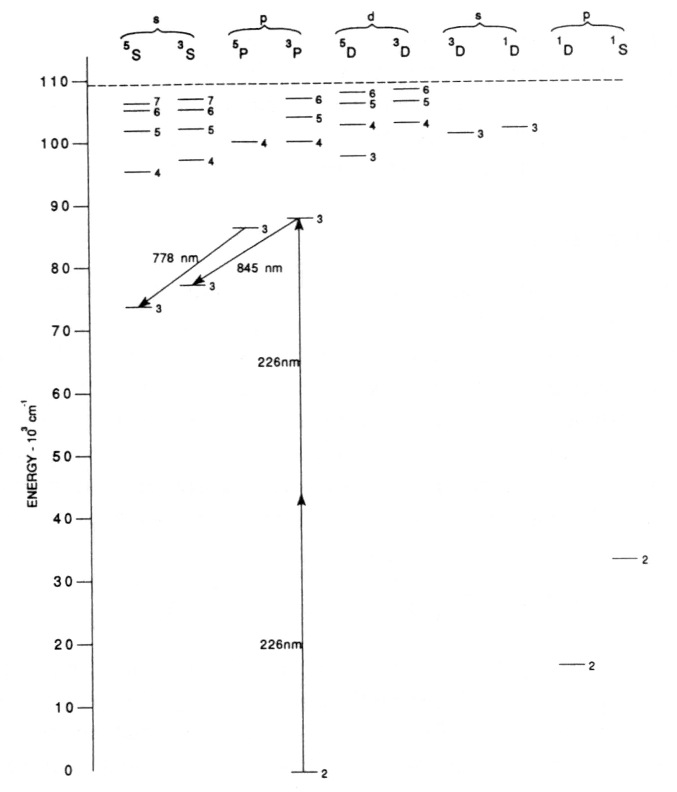
2+1 REMPI probes excited state
Resonantly Enhanced
Multi-Photon Ionization
An intense laser beam ionizes the atom and creates charges/plasma.
The ionization is strongest when the photon(s) energy equals the energy difference between excited and ground state.
Extra photons bring the energy above the ionization energy of the atom (the energy required to remove one electron from an isolated, gas-phase atom).
Oxygen: 2+1 REMPI = 2 photons to excite and 1 to ionize.
3-rd photon produces ionization
Charges provide means of detection:
  Collected using electrodes – opto-galvanic spectroscopy*
  Scatter microwave – Radar REMPI
Two-photon excitation
*J. E. M. Goldsmith, “Resonant multiphoton optogalvanic detection of atomic oxygen in flames,” J. Chem. Phys. 78, 1610-1611 (1983).

Slide 11
Radar REMPI: flame vs. laser generation of atomic oxygen
2000K flame
Atomic line of oxygen in flame is narrow (3.5 cm⁻¹ limited by laser bandwidth)
Spectral line in cold air – atomic oxygen via photolysis is 10 times broader: high temperature (50,000K) O atoms generated by intense laser pulse.
Radar REMPI can distinguish between flame induced and photolytic atomic oxygen.
Flame
cm⁻¹
Dogariu et al, “Atomic Oxygen Detection Using Radar REMPI,” CLEO 2009, OSA Technical Digest CFU4

Slide 12
Gain Narrowing
The ionization and emission processes are in competition,
but they start from the same
3p³P excited state – same two-photon excitation
Variation of forward stimulated emission (oxygen atom lasing) and Radar REMPI signal around the two-photon excitation line of atomic oxygen line at 225.6 nm.
The narrow width of the forward stimulated emission signal indicates a higher order nonlinear process as compared to the ionization-production process.
Both signals are normalized by the ultraviolet pump energy.

Slide 13
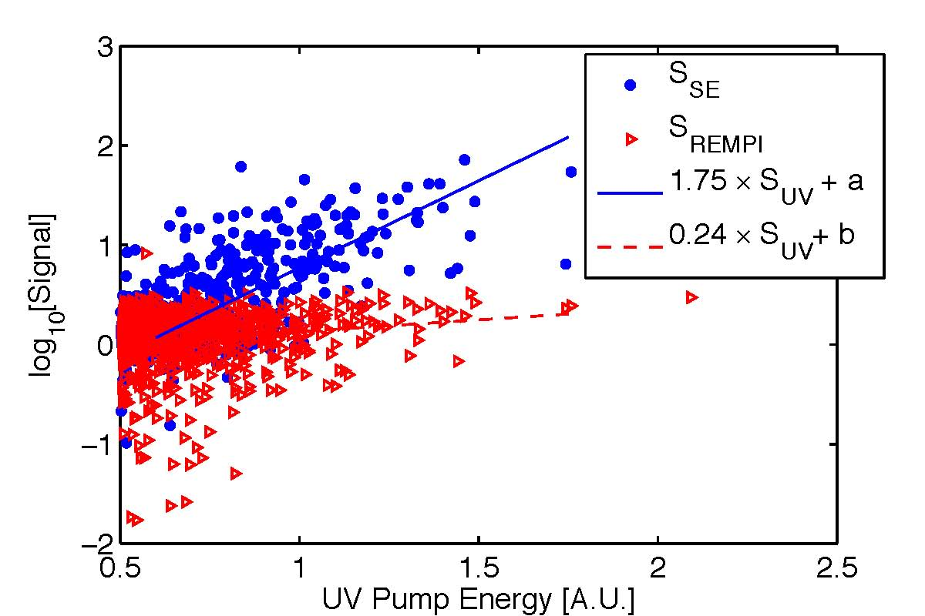
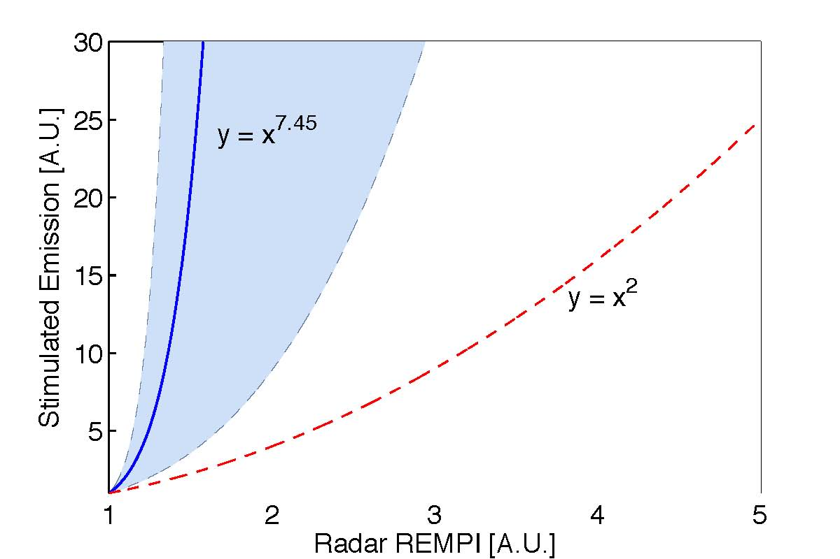
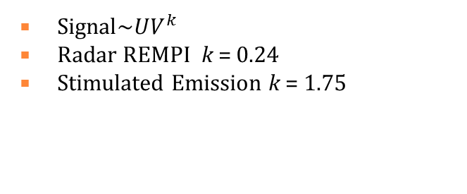
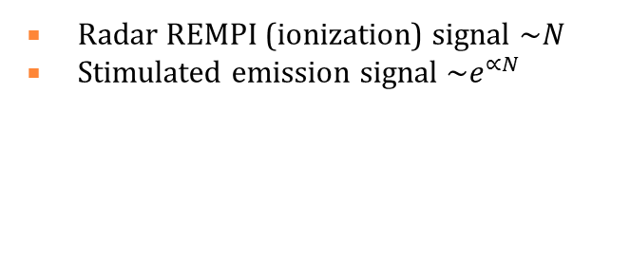
Exponential Power Scaling
Measured
Superradiance
Radar REMPI is a measure of number of the atomic oxygen atoms (verified in flames), the scaling is >> quadratic.
The exponential behavior suggests stimulated emission

Slide 14
Coherence length
Z₀<1mm, τ_{coh}=6ps
Z₀>10mm, τ_{coh}=23ps
Coherence length: auto-correlations indicate bandwidth limited pulses
(measured pulsewidth 10ps<τ<30ps).
Michelson Interferometer

Slide 15
Air laser properties
Directional emission, well defined modes
Spatial coherence: diffraction limited
Lasing threshold
Gain narrowing
Exponential Gain: high optical gain (60cm⁻¹)
Coherence length: gain medium length
Bandwidth limited pulses (10-20ps)
LASER - Light Amplification by Stimulated Emission of Radiation
The resonator cavity helps, but is not required if gain is high enough!
Siegman uses the term “mirrorless lasers”
Examples: X-ray lasers, dye laser amplifiers, Raman laser, pulsed excimer laser, interstellar masers, nitrogen and hydrogen molecular lasers

Slide 16

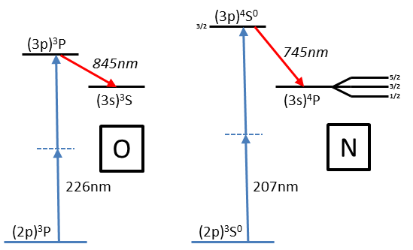
Air laser: Oxygen vs. Nitrogen?
Oxygen:
  Easy to dissociate, good conversion efficiency (0.1%)
  Complicated pump laser system: 226nm via frequency mixing, dye lasers, etc.
Nitrogen:
  Expect same or more 2-photon emission
  Pump laser – more practical: 207, 211nm directly from quadrupled Ti-Sapphire
UV
Pump

Slide 17
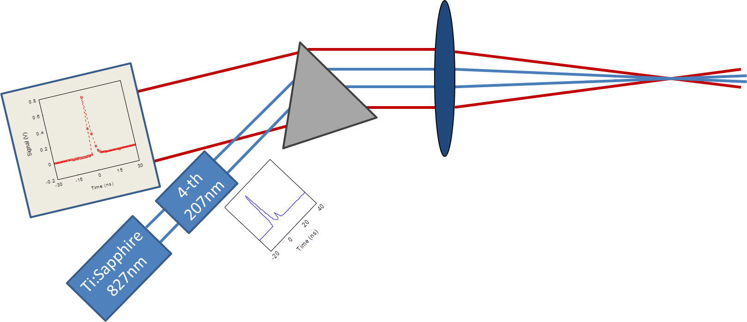
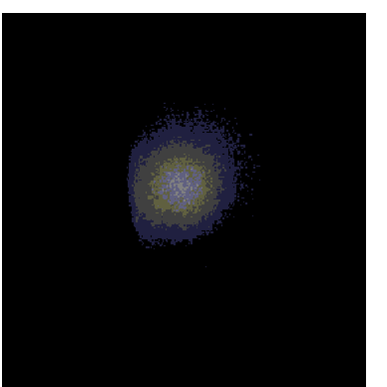
Nitrogen backwards lasing
Double pulsing leads to N-lasing
  First pulse dissociates the N2 molecule.
  Second pulse provides the two-photon excitation.
Single laser (quadrupled) – less complicated than oxygen

Slide 18
Oxygen and Nitrogen emission
Beam Divergence: Gaussian Propagation
Oxygen
Nitrogen
0.5m
6.5m
Conversion efficiency η ~ 10⁻⁴
Photon conversion efficiency ~ 0.01-0.1%
Pump @ 226nm Emission @ 845nm
10ns, 5mJ 300nJ/pulse
100ps, 0.1mJ 20nJ/pulse
Pump @ 207nm Emission @ 745nm
100ps, ~0.1mJ 4nJ/pulse

Slide 19
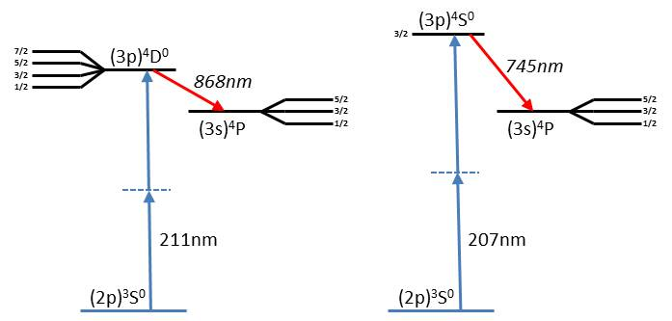
Nitrogen emission
The two lines at 744.23nm and 746.83nm correspond to the transitions from (3p)⁴S⁰_{3/2} to the (3s)⁴P_{1/2} and (3s)⁴P_{3/2}, respectively
Conversion efficiency: 4nJ @ 745nm from <0.5mJ @207nm
Photon efficiency: 2 x 10⁻⁴

Slide 20
N-laser pulsewidth:
Direct measurement
Response curves of 33GHz scope with 100 psec, 50 psec and 18 psec detectors driven by 100 fsec laser pulse.
Backward propagating nitrogen laser (blue) and the 18 psec detector response curve. Through deconvolution and assuming a Gaussian pulse, the full width half maximum pulse length of the nitrogen laser is 18.3 psec (insert)

Slide 21
Air lasing - O vs. N
Oxygen
Optical Pumping – two-photon
Nitrogen
O Pump: 226nm
O Emission: 845nm
N Pump: 207nm
N Emission: 745nm
N - two lines
(3p)⁴S⁰_{3/2} -(3s)⁴P_{1/2}
(3p)⁴S⁰_{3/2} -(3s)⁴P_{3/2}
O – single line
(3p)³P – (3s)³S

Slide 22
Air lasing - O vs. N
Laser pulse ~ 20ps
Oxygen
Nitrogen
Pulse-width < 30ps
Spectral measurement:
pulse >10ps
Atomic oxygen lifetime: 34ns!
Pulse-width ~ 20ps
Atomic oxygen lifetime: 43ns!
Fast coherent emission

Slide 23
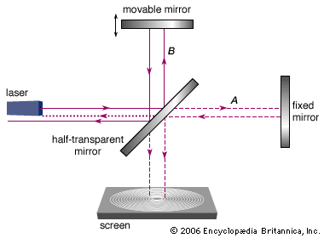
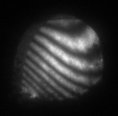
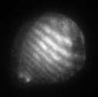
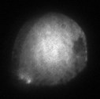
Coherence time - O vs. N
Michelson - Morley interferometer – first order autocorrelation
Measures coherence time (given by the laser bandwidth).
Z₀<1mm, τ_{coh}=6ps
Z₀>10mm, τ_{coh}=23ps
Oxygen
Coherence length: auto-correlations indicate bandwidth limited pulses!
(measured pulsewidth 10ps<τ<30ps)
Nitrogen
10 cm focusing – 10 ps coherence time
30 cm focusing – 35ps coherence time

Slide 24
N₂ vs. O₂ : Molecular dissociation
Nitrogen is harder to break than oxygen – UV pulse not strong enough:
  Need double pulsing (use most energy for dissociation: first UV pulse dissociates, later pulse excites the atoms)
  Create N-atoms in advance using another laser
Dissociation energy (enthalpy change) at 298 K:
O-O 498.34 kJ/mol 5.16eV
N-N 945.33 kJ/mol 9.78eV

Slide 25
Nitrogen pump: Double pulsing
dissociation
excitation
100% : 0%
85% : 15%
UV pump
N-laser
REMPI
70% : 30%
30% : 70%
Time (ns)
Time (ns)
UV1:UV2 (splitting ratio between UV pulses)
Best UV2: 20% (dissociation is critical)

Slide 26
Air laser and Radar REMPI:
Emission vs Ionization
Forward and backward detectors monitor the emission (lasing).
The 100 GHz microwave system monitors the Radar REMPI signal (ionization).
The REMPI (or RIS) signal measures the density of excited atoms.
REMPI – Resonantly Enhanced Multi-Photon Ionization
RIS – Resonance Ionization Spectroscopy
A. Dogariu and R. B. Miles, Appl. Opt. 50, A68 (2011).

Slide 27
Two-photon excitation spectra
UV pump
N-laser
On resonance
REMPI
Off resonance
Time (ns)
Microwave scattering shows off-resonant AND resonant signal.
The difference is due to the atomic nitrogen 2+1 REMPI.
N-laser and N-REMPI start from the same excited state.

Slide 28
Pre-dissociation of nitrogen
Nd:YAG at 1064nm sparks in air 100ns before the UV pulse(s).
The N-atom emission with pre-dissociated nitrogen is 250 times stronger;
no need for double UV pulsing.

Slide 29
N-laser with fs pre-dissociation
Pre-dissociation
FS laser
Fast signal decay (due to electron recombination and attachment to oxygen*)
Can monitor density of N atoms using Radar REMPI as early as 10ns after dissociation!
Dogariu et al., “Versatile Radar Measurement of the Electron Loss Rate in Air,” Appl. Phys. Lett. 94, 224102 (2013)
Multi-photon ionization (MPI)
via microwave scattering

Slide 30
N-lasing and Radar REMPI with fs pre-dissociation
Dissociation
N-lasing
N-REMPI
Femtosecond (50fs) pulse dissociates the nitrogen molecules (strong Radar MPI signal)
in advance of the two-photon induce atomic nitrogen Radar REMPI and N-lasing

Slide 31
N-dynamics after pre-dissociation
Radar REMPI signal contributions
resonant (atomic nitrogen ionization)
non-resonant (molecular ionization)

Slide 32
N-atoms density after dissociation
In atmospheric air – highest density of atomic nitrogen is achieved 100-500ns after
the femtosecond dissociation

Slide 33
N-laser vs pre-dissociation delay
The laser gain mimics the atomic nitrogen density as measured by the Radar REMPI.
Stimulated emission: gain coefficient proportional with the atomic nitrogen density.

Slide 34
N-laser temporal modes
Backwards N-laser emission
measured 1m away with a
fiber minispectrometer
(Ocean Optics)
Strong gain allows occasionally for several pulses
during the 100ps pumping.

Slide 35
Nanosecond pumping (O-laser)
10ns pulses with 1mJ/pulse – 300nJ/pulse emission @ 845nm
100ps pulses with 0.1mJ/pulse – 20nJ/pulse emission @845nm
η > 2x10⁻⁴

Slide 36
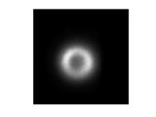
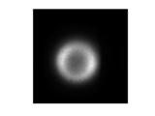
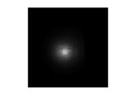
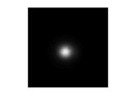
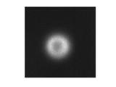
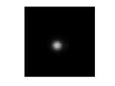
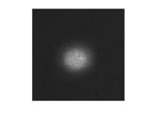
Air laser modes (O-laser)
Above resonance
Donut mode
Below resonance
Gaussian mode

Slide 37
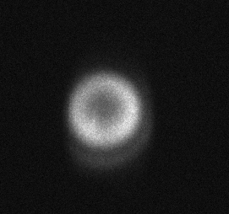
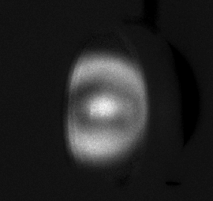
Pre-dissociation of oxygen
Backscattered oxygen laser beam at 845nm focused in air (left), and in air with a 532nm pre-pulse (right).
Pre-pulse (5μs before resonant UV pulse) dissociates oxygen molecule and generates 100 times stronger atomic oxygen lasing emission.

Slide 38
Oxygen and Nitrogen remote atmospheric lasing
 | Oxygen | Nitrogen
Pumping | Two-photon, 226nm | Two-photon, 207nm
Emission | Forward/Backward lasing, 845nm | Forward/Backward lasing, 745nm
Pulses | ~10-30ps pulses, BW limited | ~18ps pulses, BW limited
Coherence | ~6-25ps coherence time | ~10-35ps coherence time
Mode, Propagation | Gaussian, mrad divergence | Gaussian, mrad divergence
Efficiency | 0.1% photon efficiency | 0.02-0.1% photon efficiency
Pre-dissociation | 100x enhancement | 250x enhancement
Molecular dissociation | Efficient, single UV pulse | Harder, requires double pulsing – most energy for dissociation
UV pump laser availability | Hard: requires mixing lasers, and/or dye lasers | Easy: single Ti:Sapphire laser (λ/4)

Slide 39
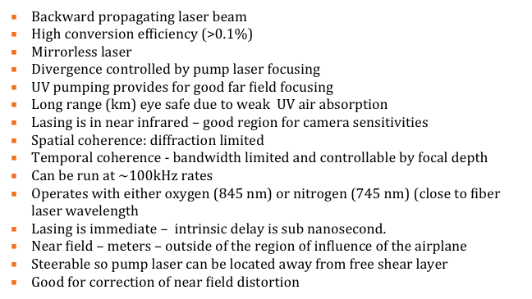
Backward Air Laser
Guide Star Properties

Slide 40
Remote guide star
100 picosecond UV laser beam transmitted to remote focus
Creates lasing in air which propagates back along the pump beam
Return beam is an IR laser (845 or 745 nm)
Divergence of return beam a factor of ~3.5 greater than transmitted beam
Photon efficiency ~ 10⁻³

Slide 41
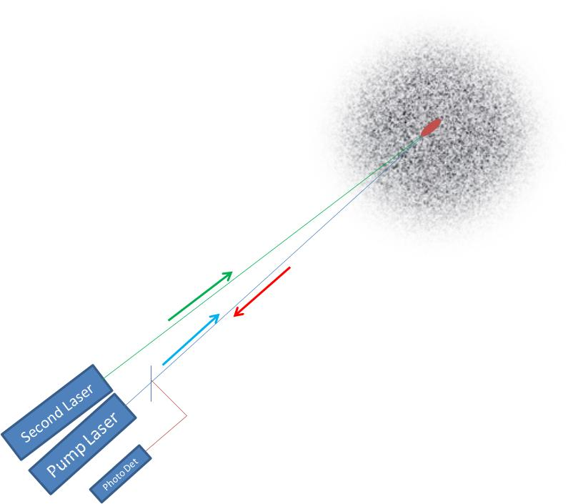
Remote detection using atomic oxygen lasing
845nm
detector
Target
O-laser
226nm
pump
laser
Target
laser
The 226nm pump laser creates the backwards emitting 845nm air laser
The Target laser interacts resonantly with the target cloud, affecting the pump and air lasers:
  Differential index change: small changes in the pump beam translate in big changes for the air laser (highly nonlinear)
  Raman gain: Target laser tuned to provide stimulated Raman scattering (SRS) for the air laser

Slide 42
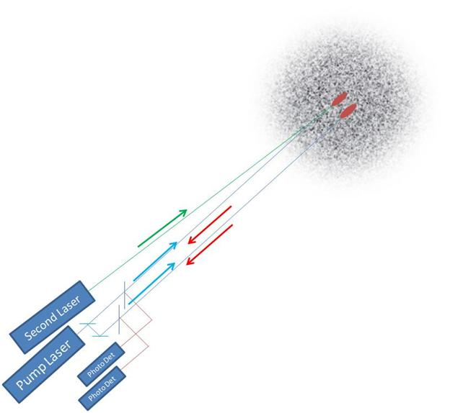
Pulse to pulse reference
A second backward propagating air laser created by the same pump acts as a reference.
Minimizes pulse to pulse fluctuations of the pump laser.
Minimizes distortion due to propagation through the air.

Slide 43
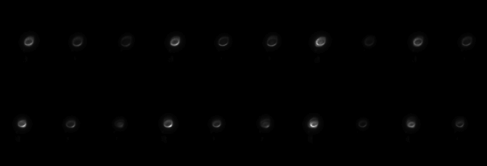

Dual air laser for remote reference
Simultaneous dual backward lasing pulse pairs.
Bottom: 50 sequential air laser pulse pairs
Top: higher resolution images of 10 laser pulse pairs
Strong correlation between the two air lasers
1000 pulse pairs statistics show the pulse intensity variance reducing from 50% and 70% for each pulse, to less than 2% for their ratio

Slide 44
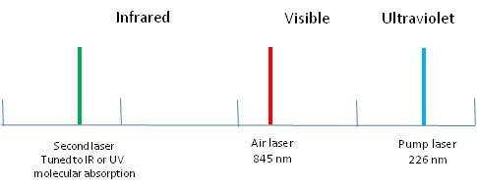
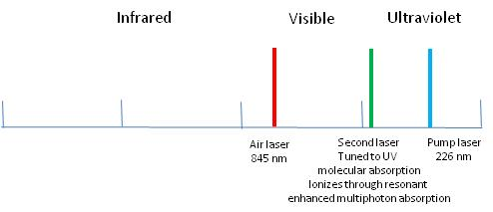
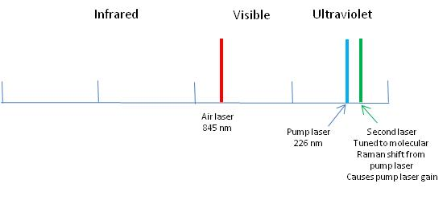
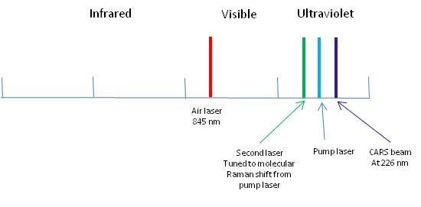
Methods for Remote Detection
Use the backward lasing to monitor the modulation of the forward pump beam
Modulate the index of refraction of the air through absorption of the second laser into a molecule of interest, leading to heating of the air
Modulate the index of refraction of the air through multi photon absorption leading to ionization of the molecular species of interest.
Modulate the amplitude of the pump laser through a stimulated Raman interaction where the pump laser is either amplified or attenuated through a nonlinear interaction with a selected molecular species.
Create new forward propagating beam at 226 nm through a CARS interaction and use the 226 to create the backward lasing

Slide 45
Air Laser: Conclusions
Molecular dissociation followed by two-photon excitation of the atomic fragments – strong stimulated emission gain.
Focusing geometry aids in establishing lasing direction.
Dual pulses ensure efficient dissociation (required for nitrogen) and excitation.
Strong forward and backward lasing with low divergence.
High (0.1%) photon efficiency.
Short pulses: 10-20ps (spectral and temporal measurements).
Coherent emission: coherence length mimics the gain medium length.
All-optical controlled gain and directional emission.
Air laser: Remote detection laser source
Used as a probe in (spontaneous and/or stimulated) Raman for molecular identification in air.
Used as a remote detector for changes in the pump laser (induced resonantly to provide molecular specificity).

