Slide 1
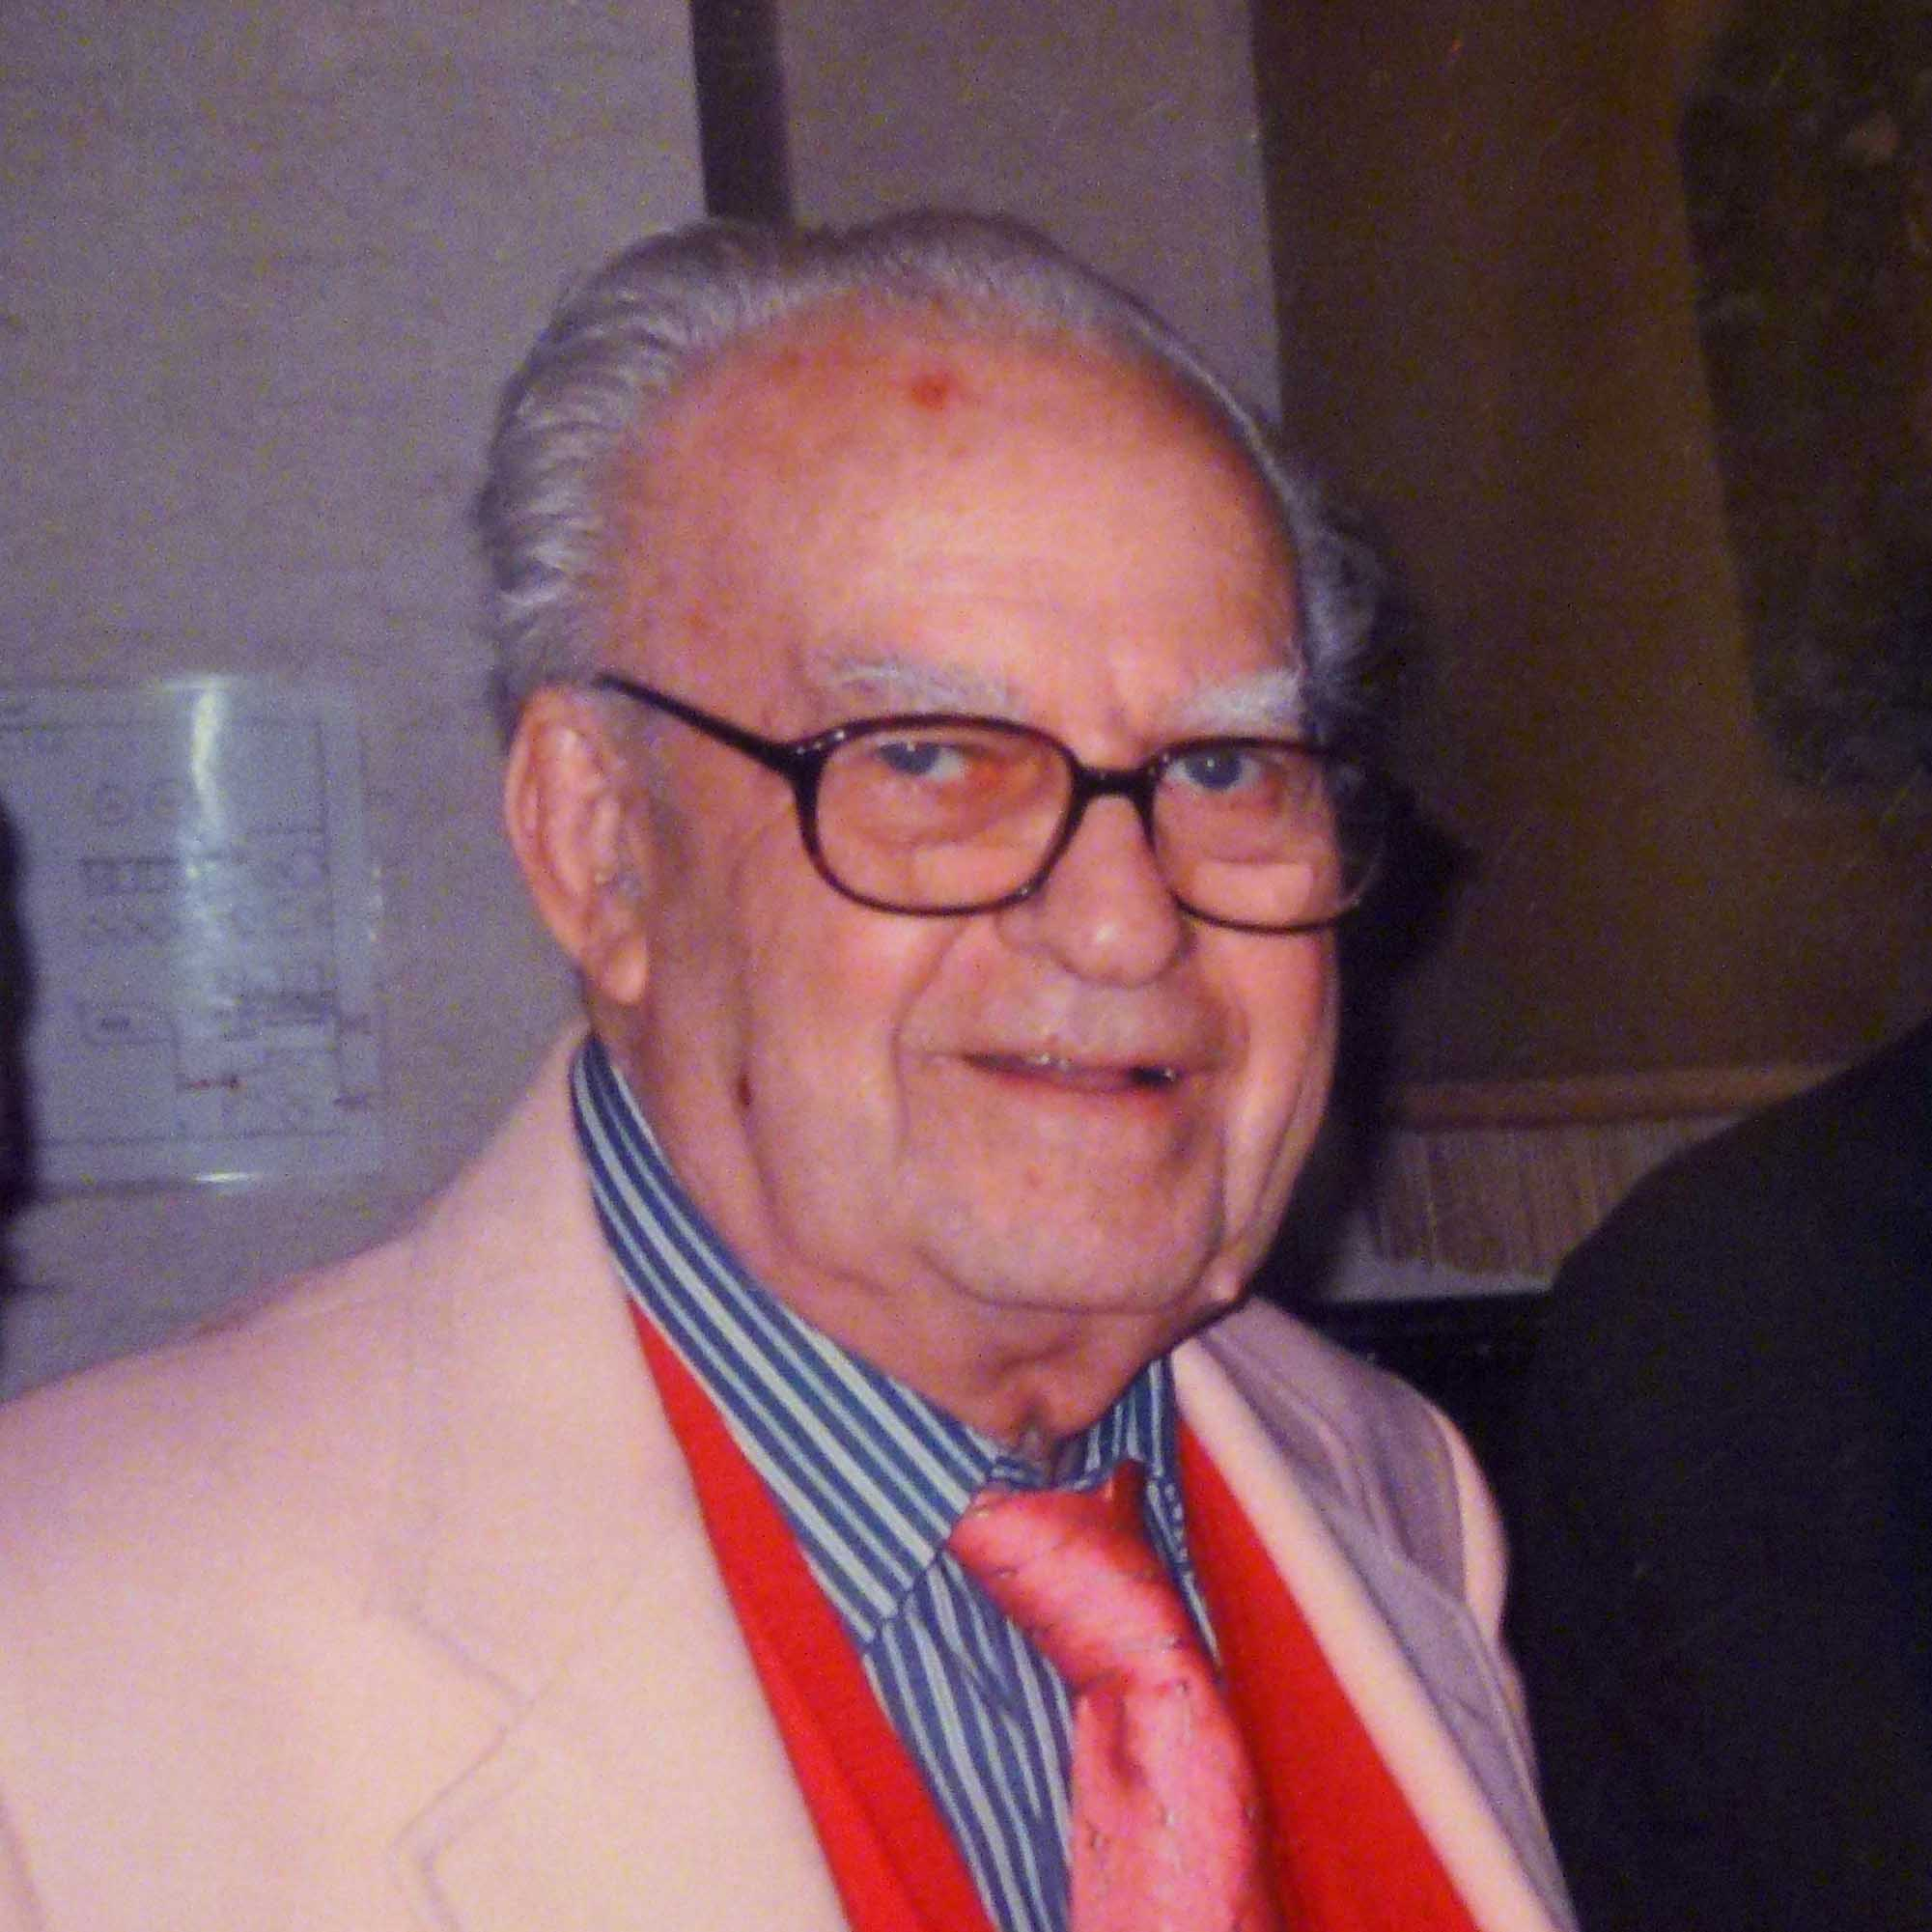
Isidore Zeitz’s contributions to the Geological Soc. of Washington
March 1919 (Bronx) – Feb 9 2013 (Reston)
Math, Physics: BS,MS, Ph.D, City College NY, Catholic
USGS (1940’s-1978), Phoenix (1978-1985), Consulting
Michael Purucker (SGT at Goddard Space Flight Center, NASA) w. contributions from Lewis Zeitz, Patrick Taylor, Wright Horton, Jeff Grossman, Richard Blakely, Andrew Griscom, Peter Johnson and George Vranas
Upcoming obituaries will appear in The Leading Edge and EOS

Slide 2
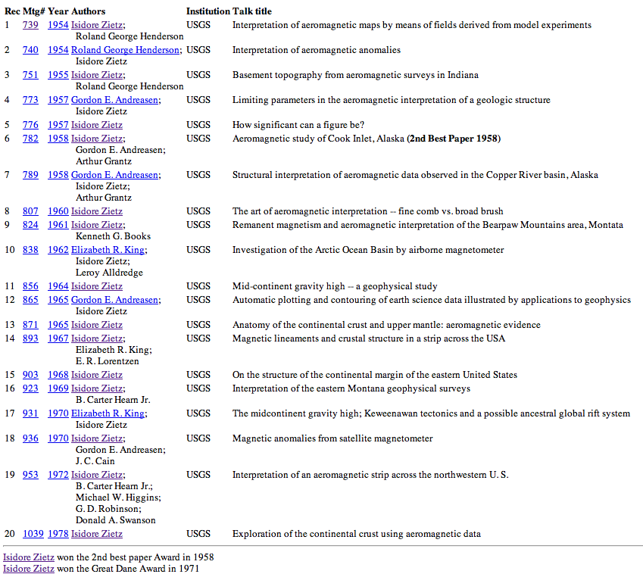
Izzy’s GSW talks

Slide 3
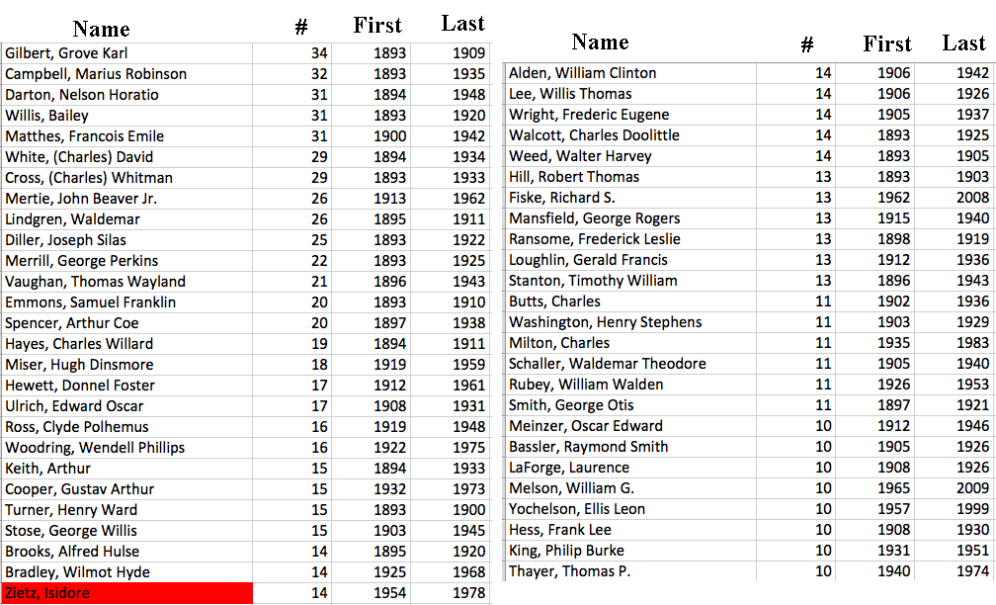
Individuals who gave more than 10 talks
Courtesy of Jeff Grossman

Slide 4
Izzy’s Achievements
Advocacy of airborne magnetic method
Developing mathematical and physical basis for interpretation of magnetic field observations (depth to magnetic source, continuation, derivatives)
Geologic interpretations (w. geologists)
Appalachians (NY Alabama lineament, Central Piedmont suture, Eastern Piedmont fault system, Alleghanian plutons, Suwannee-Wiggins suture)
Mid-continent rift
Dead sea rift
Jamaican step-over basins
Magnetic compilations of the US
Resource interpretations (oil/gas & minerals)
Saudi Arabia- Mag. identification of a basin SE of Riyadh that was subsequently discovered to harbor a supergiant gas accumulation

Slide 5
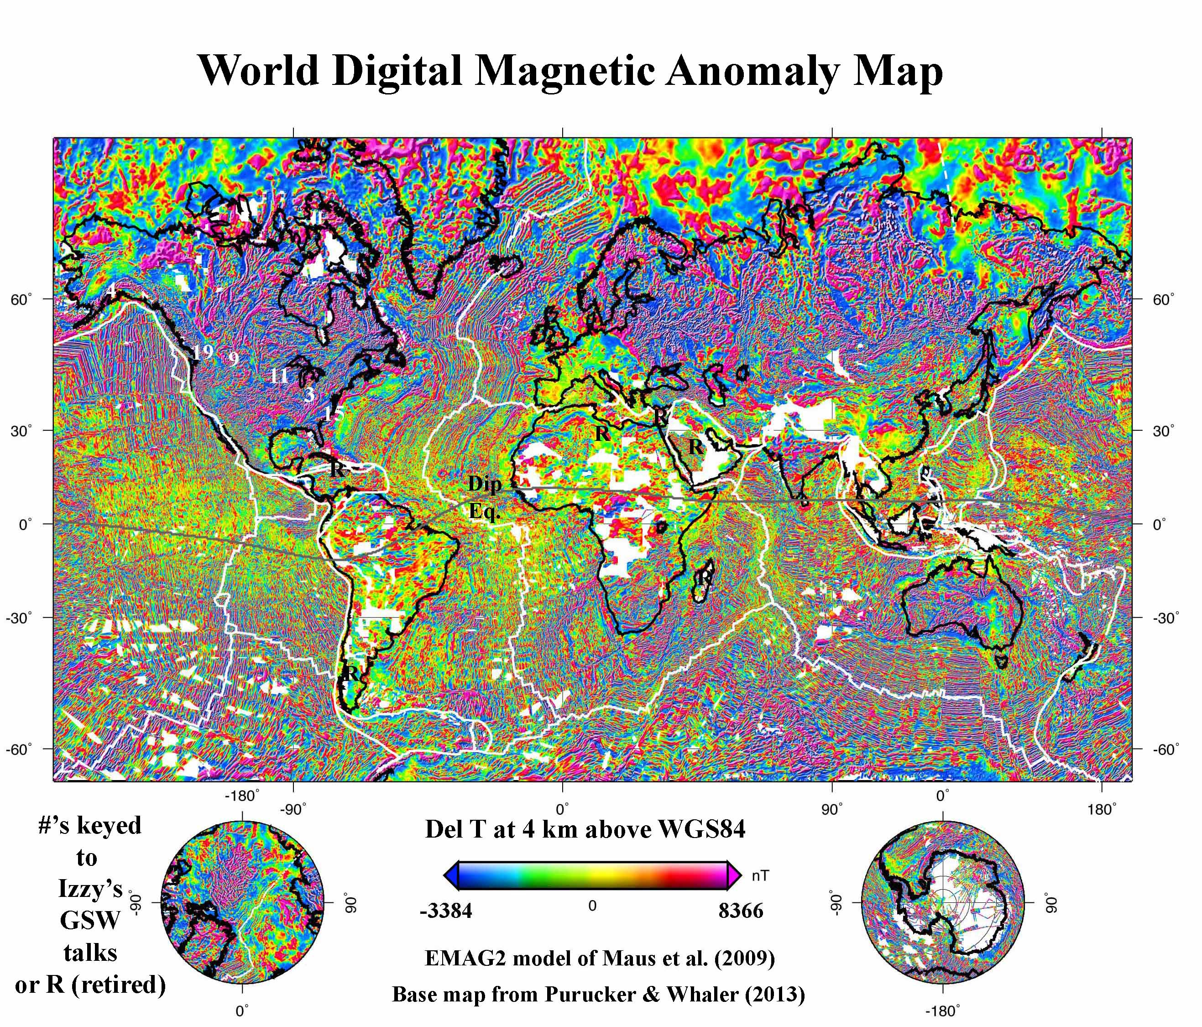
Where did Izzy work?

